Slide 1
Soil microbiome classification using - Random Forest and SVM
- SHAP and SHAPG

Slide 2
Overview (Taken from Prof. Marroni’s instructions)
Aim: compare the ability of three different sequencing technologies in classifying soils of different origin or that underwent different treatments.
Expected results
Result 1: For each condition, one graph showing the prediction ability of the Random Forest approach using the three sequencing technologies. A possible example output plot is provided below, and is also in the file LDA_example.docx
Result 2: Use SHAP to identify the features (bacterial genera) that most contribute to the discrimination. Are there summary statistics to be used, e.g. % of explained variance or something similar?
Result 3: Repeat the classification only using the most important features.

Slide 3
Quick Review on SHAP plots
Both Beeswarm and Bar charts sort the features from top to bottom based on their global importance (which feature has the biggest overall impact on the model).
یه لیبل داریم که مثبت بودنش مدنظرمونه (مثلا سرطان داشتن). حالا یه سری فیچر هم داریم، مثلا فشار خون. مقادیر زیاد هر فیچر با نقاط قرمز نشون داده میشن و مقادیر کم/کوچک با نقاط آبی. تجمع این نقاط آبی یا قرمز مهمه که کدوم سمت قرار گرفته. مقدار زیاد یک فیچر مثل فشار خون (با رنگ قرمز، نشان بالا بودن مقدارش) در سمت راست این پلات یعنی که مقادیر بالای فشار خون، احتمال و شانس بالا رفتن سرطان (لیبل مثبت) رو بالا میبرن. مثلا اگر یه فیچر دیگه مثل چربی خون داشته باشیم که کپه های از نقاط آبی (نشانگر مقدار کم این ویژگی) بیفتن سمت چپ محور، میگیم که کم بودن فشار خون، شانس/احتمال سرطان داشتن رو پایین میاره.

Slide 4
Important Points
Use the newest version of datasets (normalized with DESeq2 software)
Apply feature selection before applying Machine Learning model (Removing zero-importance features)
Using another ML model other than Random Forest (RF) → I first wanted to use XGBoost but then I thought RF and XGBoost are both from the same family called Ensemble models. So I used LSVM. In other words, RF has random and non-linear nature while LSVM is linear and deterministic (please let me know if you disagree with my choice).
For Autoclave and HeatRoot, use SHAP, and select 20, 10, 3 features to retrain the ML model.
For Autoclave and HeatRoot, use SHAPG and select 20, 10, 3 features to retrain the ML model.
In the case of soil (which is a multi-class classification, and we have more than 2 values for it), I once used the union of all 20 features per each value. In the case of 3 features, I first used the common features between each 20 features of each value (yellow cells in slides 8-13 & 17-22). Then, I applied Borda Social Choice method to pick 3 top common features in them.
75% of data was used as train, and 25% as test set.
SHAP and SHAPG is applied on the Train set.

Slide 5

Methodology’s Workflow
Preprocessing
Train Data
SHAP(G)
SHAP(G) 20
SHAP(G) 10
SHAP(G) 3
Data Acquisition
Train classifier
Test Data
Prediction

Slide 6
Methodology’s Workflow
Taxonomical assignment
& Preprocessing
Train Data
SHAP(G)
Train classifier
SHAP(G) 20
SHAP(G) 3
Test Data
Prediction

Slide 7
Number of Features after Removing Zero-importance Features
Aviti after feature selection
soil: 35
autoclave: 59
HeatRoot: 69
Miseq after feature selection
soil: 52
autoclave: 55
HeatRoot: 71
Novaseq after feature selection
soil: 34
autoclave: 56
HeatRoot: 66

Slide 8
Accuracy results of Random Forest per each dataset (Feature selection/reduction applied)
Binary Classification
Multi-class Classification
Accuracy for Aviti
Condition | All Reduced Features | 20 SHAP features | 10 SHAP features | 3 SHAP features
Autoclave | 0.88 | 0.88 | 0.88 | 0.55
Heat root | 0.33 | 0.33 | 0. 77 | 0.44
Accuracy for Aviti
Condition | All Reduced Features | 26 SHAP features | 3 SHAP features
Soil | 1.0 | 1.0 | 1.0
Accuracy for Miseq
Condition | All Reduced Features | 20 SHAP features | 10 SHAP features | 3 SHAP features
Autoclave | 0.88 | 1.0 | 1.0 | 0.77
Heat root | 0.55 | 0.44 | 0.44 | 0.44
Accuracy for Miseq
Condition | All Reduced Features | 28 SHAP features | 3 SHAP features
Soil | 1.0 | 1.0 | 0.77
Accuracy for Novaseq
Condition | All Reduced Features | 20 SHAP features | 10 SHAP features | 3 SHAP features
Autoclave | 0.77 | 0.66 | 0.88 | 0.88
Heat root | 0.66 | 0.77 | 0.55 | 0.55
Accuracy for Novaseq
Condition | All Reduced Features | 23 SHAP features | 3 SHAP features
Soil | 1.0 | 1.0 | 1.0

Slide 9
Accuracy results of LSVM per each dataset (Feature selection/reduction applied)
Binary Classification
Multi-class Classification
Accuracy for Aviti
Condition | All Reduced Features | 20 SHAP features | 10 SHAP features | 3 SHAP features
Autoclave | 0.88 | 0.88 | 0.88 | 0.88
Heat root | 0.77 | 0.22 | 0.66 | 0.66
Accuracy for Aviti
Condition | All Reduced Features | 24 SHAP features | 3 SHAP features
Soil | 1.0 | 1.0 | 1.0
Accuracy for Miseq
Condition | All Reduced Features | 20 SHAP features | 10 SHAP features | 3 SHAP features
Autoclave | 0.88 | 0.66 | 0.66 | 0.22
Heat root | 0.55 | 0.55 | 0.66 | 0.66
Accuracy for Miseq
Condition | All Reduced Features | 30 SHAP features | 3 SHAP features
Soil | 1.0 | 1.0 | 0.88
Accuracy for Novaseq
Condition | All Reduced Features | 20 SHAP features | 10 SHAP features | 3 SHAP features
Autoclave | 0.66 | 0.77 | 0.77 | 0.22
Heat root | 0.55 | 0.66 | 0.66 | 0.77
Accuracy for Novaseq
Condition | All Reduced Features | 23 SHAP features | 3 SHAP features
Soil | 1.0 | 1.0 | 1.0

Slide 10
List of Top 20 SHAP Features for Aviti, Random Forest
Number | Autoclave (yes)'s SHAP | HeatRoot (yes)'s SHAP
1 | Gemmata | YC-ZSS-LKJ147
2 | Neobacillus | Salinispira
3 | Ramlibacter | Massilia
4 | Methanosarcina | Algoriphagus
5 | Niallia | Microbacterium
6 | UBA6140 | Candidatus Arcanobacter
7 | Imperialibacter | Reyranella
8 | OLB13 | Candidatus Ovatusbacter
9 | Methylobacter | Rhodopila
10 | Flavobacterium | Candidatus Omnitrophus
11 | Stenotrophobacter | Erythrobacter
12 | Telmatocola | Mesorhizobium
13 | Dysgonomonas | Lacihabitans
14 | Blastocatella | Variovorax
15 | Methyloversatilis | Xylophilus
16 | Pseudofulvimonas | Pseudoduganella
17 | Mesobacillus | Bradyrhizobium
18 | Sphingomonas | Ramlibacter
19 | Sulfurifustis | OLB13
20 | Reyranella | Mycobacterium
Number | Soil (Manure)'s SHAP | Soil (Peat)'s SHAP | Soil (Sand)'s SHAP
1 | Roseimaritima | SWB02 | Ideonella
2 | Croceibacterium | Roseimaritima | oc32
3 | SWB02 | Croceibacterium | Planctopirus
4 | Fermentimonas | Ideonella | Azotobacter
5 | oc32 | Hyphomicrobium | Roseimaritima
6 | C1-B045 | C1-B045 | Chthonobacter
7 | Sneathiella | Sneathiella | Acidovorax
8 | Hyphomicrobium | Acidovorax | SWB02
9 | Chthonobacter | Agrobacterium | Agrobacterium
10 | Planctopirus | Labrys | Labrys
11 | Azotobacter | Fermentimonas | Croceibacterium
12 | Ideonella | Planctopirus | Fermentimonas
13 | Methylobacter | Azotobacter | Hyphomicrobium
14 | Zavarzinella | Methylobacter | Cellvibrio
15 | Spirochaeta 2 | Candidatus Solibacter | Niveispirillum
16 | Candidatus Solibacter | Fimbriiglobus | Spirochaeta 2
17 | Parafilimonas | Spirochaeta 2 | Candidatus Solibacter
18 | Oligoflexus | Oligoflexus | Parafilimonas
19 | Ureibacillus | Ureibacillus | Oligoflexus
20 | Planifilum | Planifilum | Ureibacillus

Slide 11
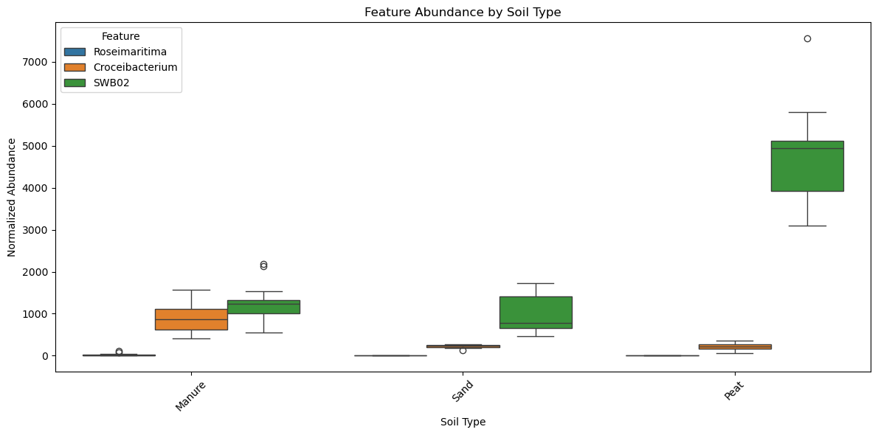
Boxplot of the Soil features abundance for Aviti, Random Forest

Slide 12
List of Top 20 SHAP Features for Miseq, Random Forest
Number | Autoclave's SHAP | HeatRoot's SHAP
1 | Chryseolinea | Ilumatobacter
2 | Imperialibacter | Pedobacter
3 | Abditibacterium | MND1
4 | YC-ZSS-LKJ147 | Oleiharenicola
5 | Rhodoplanes | Phaselicystis
6 | Methylobacillus | Chitinophaga
7 | Candidatus Nitrosoarchaeum | Chryseotalea
8 | mle1-7 | Pseudolabrys
9 | Bauldia | Agriterribacter
10 | Hirschia | Hydrogenophaga
11 | Devosia | Opitutus
12 | Ellin6055 | Hypericibacter
13 | Ferruginibacter | Pedomicrobium
14 | IS-44 | Luteolibacter
15 | Parageobacillus | YC-ZSS-LKJ147
16 | Mesobacillus | Subgroup 10
17 | Ramlibacter | Candidatus Solibacter
18 | Dinghuibacter | Lentzea
19 | Hassallia | Methylotenera
20 | Dokdonella | Labrys
Number | Soil (Manure)'s SHAP | Soil (Peat)'s SHAP | Soil (Sand)'s SHAP
1 | Croceibacterium | SWB02 | Sphingorhabdus
2 | CL500-3 | Pseudomonas | Shinella
3 | Dokdonella | Arsenicitalea | SWB02
4 | SWB02 | Croceibacterium | OLB12
5 | Gemmata | Dokdonella | Pseudomonas
6 | Arsenicitalea | Oleiharenicola | CL500-3
7 | Oleiharenicola | CL500-3 | Acidibacter
8 | Sphingorhabdus | Ilumatobacter | Dokdonella
9 | Bradyrhizobium | Sphingorhabdus | Steroidobacter
10 | Pseudomonas | Opitutus | Croceibacterium
11 | Shinella | OLB12 | Bosea
12 | Opitutus | Gemmata | Gemmata
13 | Ilumatobacter | Shinella | Ferribacterium
14 | JGI 0001001-H03 | Bradyrhizobium | Rubrivivax
15 | Geomonas | Steroidobacter | MND1
16 | Acidibacter | Planctomicrobium | Arsenicitalea
17 | Kineobactrum | Sphingopyxis | Dechloromonas
18 | Planctomicrobium | MND1 | Luteolibacter
19 | Rubrivivax | Kineobactrum | Methylophilus
20 | Dechloromonas | Acidibacter | Bradyrhizobium

Slide 13
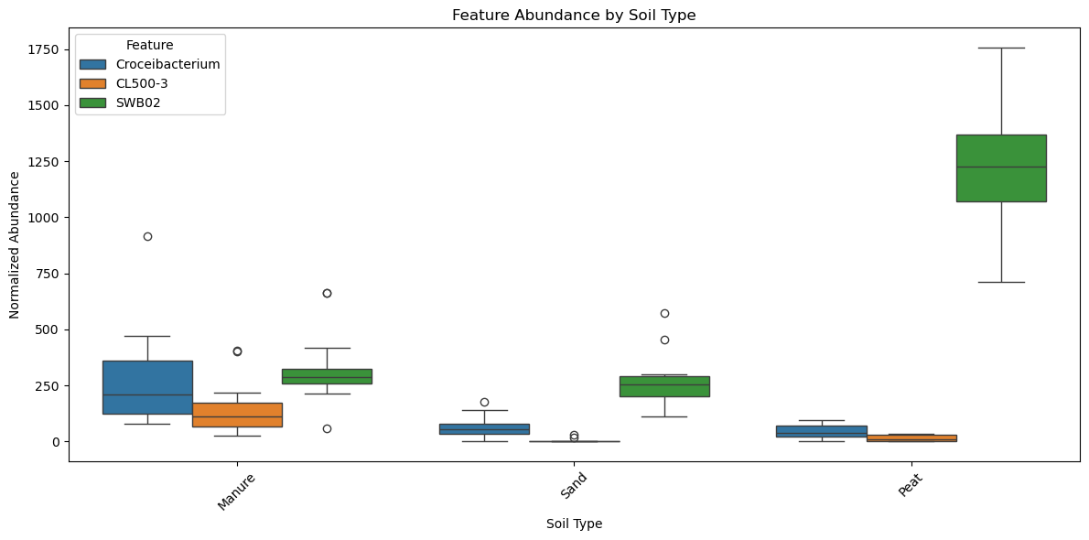
Boxplot of the Soil features abundance for Miseq, Random Forest

Slide 14
List of Top 20 SHAP Features for Novaseq, Random Forest
Number | Autoclave's SHAP | HeatRoot's SHAP
1 | Neobacillus | Algoriphagus
2 | Ammoniphilus | Kribbella
3 | Stenotrophobacter | Apilactobacillus
4 | Kribbella | CL500-3
5 | Snodgrassella | Acinetobacter
6 | Gemmata | Candidatus Nitrosoarchaeum
7 | BIyi10 | Rhodovastum
8 | Aminobacter | Longimicrobium
9 | Cupriavidus | Stenotrophobacter
10 | Immundisolibacter | Candidatus Omnitrophus
11 | [Aquaspirillum] arcticum group | Pararhizobium
12 | Slackia | Niallia
13 | Noviherbaspirillum | Noviherbaspirillum
14 | Novosphingobium | Ketobacter
15 | Marinoscillum | Hassallia
16 | Brevibacillus | Ferruginibacter
17 | Verrucosispora | Aquicella
18 | Subgroup 10 | Hydrogenispora
19 | Crocinitomix | Candidatus Xiphinematobacter
20 | OLB13 | Meiothermus
Number | Soil (Manure)'s SHAP | Soil (Peat)'s SHAP | Soil (Sand)'s SHAP
1 | Ketobacter | Inhella | Inhella
2 | Afipia | Plot4-2H12 | Plot4-2H12
3 | Candidatus Berkiella | Afipia | Runella
4 | Plot4-2H12 | Candidatus Berkiella | Pseudarthrobacter
5 | Inhella | Ketobacter | BIyi10
6 | Rhodopila | Dyella | Candidatus Berkiella
7 | Dyella | Pararhizobium | Pararhizobium
8 | BIyi10 | DSSD61 | Rhodopila
9 | Methanosarcina | Pseudarthrobacter | Ketobacter
10 | DSSD61 | Runella | Methanosarcina
11 | Runella | Methanosarcina | Bauldia
12 | Pseudarthrobacter | Rhodopila | Subgroup 10
13 | Pararhizobium | Bauldia | Solimonas
14 | IS-44 | Caldicoprobacter | Dyadobacter
15 | Subgroup 10 | Subgroup 10 | Brevifollis
16 | Bauldia | Dyadobacter | IS-44
17 | Hydrogenispora | IS-44 | Ruminofilibacter
18 | Dyadobacter | Brevifollis | Microbacterium
19 | Brevifollis | Hydrogenispora | Hydrogenispora
20 | Ruminofilibacter | Ruminofilibacter | Caldicoprobacter

Slide 15
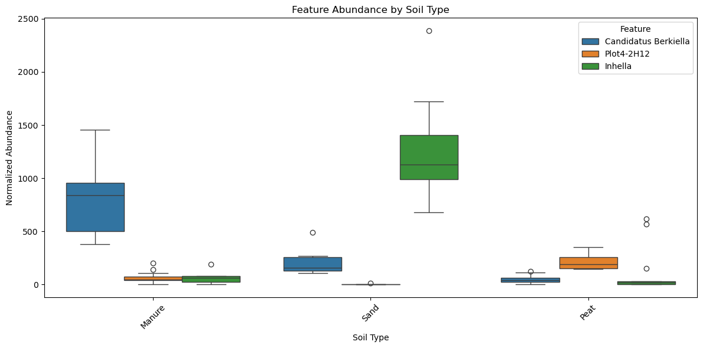
Boxplot of the Soil features abundance for Novaseq, Random Forest

Slide 16
List of Top 20 SHAP Features for Aviti, LSVM
Number | Autoclave (yes)'s SHAP | HeatRoot (yes)'s SHAP
1 | Flavobacterium | Terrimonas
2 | Sphingomonas | Chryseotalea
3 | Arenimonas | Subgroup 10
4 | Hassallia | MND1
5 | Methylobacter | Arenimonas
6 | Ramlibacter | Ramlibacter
7 | Rubrivivax | Bradyrhizobium
8 | Gemmata | Sediminibacterium
9 | Stenotrophobacter | Devosia
10 | Pelotalea | Gemmatimonas
11 | Sediminibacterium | Cellvibrio
12 | Paucibacter | Ohtaekwangia
13 | UBA6140 | Luteolibacter
14 | Iamia | YC-ZSS-LKJ147
15 | Acidiferrimicrobium | Ferribacterium
16 | Hirschia" | Algoriphagus
17 | Niastella | Variovorax
18 | Pseudorhodoplanes | Lentzea
19 | Reyranella | Rhizobacter
20 | Conexibacter | Massilia
Number | Soil (Manure)'s SHAP | Soil (Peat)'s SHAP | Soil (Sand)'s SHAP
1 | SWB02 | SWB02 | SWB02
2 | Croceibacterium | Gemmata | Ideonella
3 | Opitutus | Polycyclovorans | Opitutus
4 | Methylobacter | Croceibacterium | Sphingorhabdus
5 | Gemmata | Ideonella | Polycyclovorans
6 | Hyphomicrobium | Streptomyces | Gemmata
7 | Fimbriiglobus | Sphingorhabdus | Azotobacter
8 | Cellvibrio | Opitutus | Hyphomicrobium
9 | YC-ZSS-LKJ147 | Hyphomicrobium | YC-ZSS-LKJ147
10 | BIyi10 | Azotobacter | Streptomyces
11 | Candidatus Solibacter | Fimbriiglobus | Croceibacterium
12 | Agrobacterium | BIyi10 | Agrobacterium
13 | Streptomyces | Agrobacterium | Acidovorax
14 | Ideonella | Candidatus Solibacter | Chthonobacter
15 | Acidovorax | Methylobacter | Cellvibrio
16 | Polycyclovorans | Cellvibrio | BIyi10
17 | Parafilimonas | Spirochaeta 2 | Candidatus Solibacter
18 | C1-B045 | Acidovorax | Fimbriiglobus
19 | Spirochaeta 2 | Chthonobacter | Labrys
20 | Sneathiella" | YC-ZSS-LKJ147 | Spirochaeta 2

Slide 17
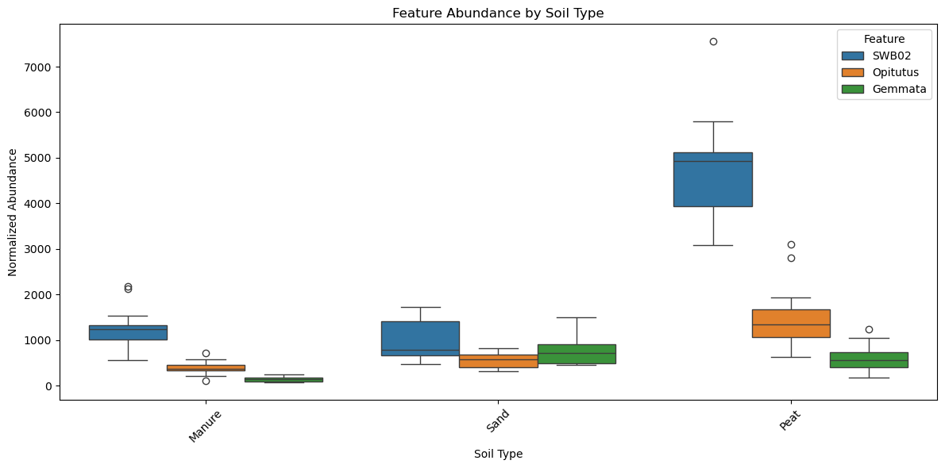
Boxplot of the Soil features abundance for Aviti, LSVM

Slide 18
List of Top 20 SHAP Features for Miseq, LSVM
Number | Autoclave's SHAP | HeatRoot's SHAP
1 | IS-44 | UBA6140
2 | Dokdonella | Pseudomonas
3 | Methylobacillus | Methylotenera
4 | Candidatus Solibacter | Oleiharenicola
5 | Ferruginibacter | Opitutus
6 | Chthoniobacter | Croceibacterium
7 | Devosia | Candidatus Solibacter
8 | Hirschia | Dongia
9 | Bauldia | MND1
10 | Ramlibacter | Steroidobacter
11 | Chryseotalea | Ilumatobacter
12 | Phenylobacterium | YC-ZSS-LKJ147
13 | Ellin6055 | Pirellula
14 | YC-ZSS-LKJ147 | Sphingomonas
15 | Panacibacter | Subgroup 10
16 | Ellin517 | Reyranella
17 | Luteolibacter | Hassallia
18 | Pir4 lineage | Phenylobacterium
19 | Rhodoplanes | Chryseotalea
20 | mle1-7 | Ellin6067
Number | Soil (Manure)'s SHAP | Soil (Peat)'s SHAP | Soil (Sand)'s SHAP
1 | SWB02 | Steroidobacter | SWB02
2 | Pseudomonas | Pseudomonas | Pseudomonas
3 | Steroidobacter | Acidibacter | Acidibacter
4 | Dokdonella | SWB02 | Steroidobacter
5 | Acidibacter | Luteolibacter | Luteolibacter
6 | Oleiharenicola | Dokdonella | Shinella
7 | Croceibacterium | Ellin6067 | Dechloromonas
8 | JGI 0001001-H03 | Sphingomonas | Geomonas
9 | Ellin6067 | MND1 | Opitutus
10 | CL500-3 | Geomonas | Sphingomonas
11 | Gemmata | Polycyclovorans | Ellin6067
12 | Ohtaekwangia | Shinella | OLB12
13 | Ilumatobacter | Pedomicrobium | Sphingorhabdus
14 | Polycyclovorans | Sphingorhabdus | Polycyclovorans
15 | Paludibaculum | Methylophilus | Arsenicitalea
16 | Arsenicitalea | OLB12 | MND1
17 | Kineobactrum | Dechloromonas | Ilumatobacter
18 | Luteolibacter | Croceibacterium | Methylophilus
19 | Pedomicrobium | JGI 0001001-H03 | Pirellula
20 | MND1 | Opitutus | Rubrivivax

Slide 19
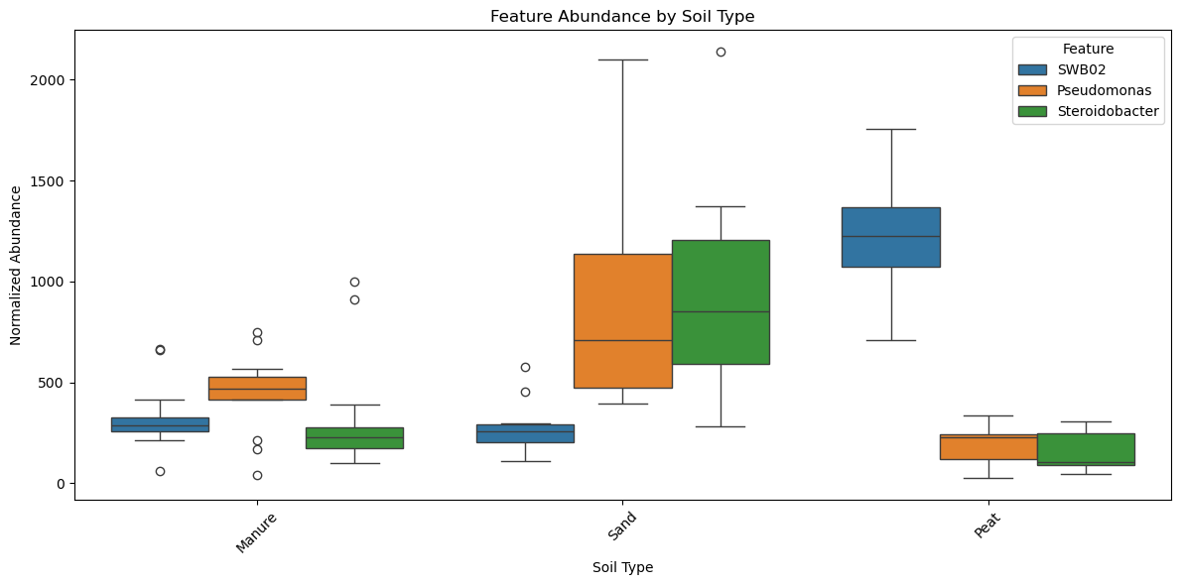
Boxplot of the Soil features abundance for Miseq, LSVM

Slide 20
List of Top 20 SHAP Features for Novaseq, LSVM
Number | Autoclave's SHAP | HeatRoot's SHAP
1 | Ramlibacter | Shinella
2 | Gemmata | CL500-3
3 | BIyi10 | Novosphingobium
4 | Novosphingobium | Hassallia
5 | TM7a | Ahniella
6 | Methylobacillus | Aquicella
7 | Pseudomonas | Ferruginibacter
8 | Algoriphagus | BIyi10
9 | Marinoscillum | Curvibacter
10 | CL500-3 | Acinetobacter
11 | Subgroup 10 | Chryseotalea
12 | Kribbella | Rhodovastum
13 | Aminobacter | Solirubrobacter
14 | Mesobacillus | Anaerolinea
15 | Agrobacterium | Aeromicrobium
16 | Cupriavidus | Candidatus Nitrosoarchaeum
17 | Asticcacaulis | Steroidobacter
18 | Candidatus Protochlamydia | Algoriphagus
19 | Niallia | Noviherbaspirillum
20 | Neobacillus | Candidatus Omnitrophus
Number | Soil (Manure)'s SHAP | Soil (Peat)'s SHAP | Soil (Sand)'s SHAP
1 | Subgroup 10 | Fimbriiglobus | Bauldia
2 | Fimbriiglobus | Subgroup 10 | Subgroup 10
3 | Bauldia | Dechloromonas | Fimbriiglobus
4 | BIyi10 | IS-44 | Inhella
5 | IS-44 | BIyi10 | Pararhizobium
6 | Candidatus Berkiella | Inhella | Dechloromonas
7 | Ketobacter | Arenimonas | Pseudarthrobacter
8 | Arenimonas | Pseudarthrobacter | Arenimonas
9 | Ferribacterium | Pararhizobium | IS-44
10 | Microbacterium | Bauldia | Hydrogenispora
11 | Constrictibacter | Candidatus Berkiella | Dyadobacter
12 | Pararhizobium | DSSD61 | Ferribacterium
13 | Afipia | Ferribacterium | Candidatus Berkiella
14 | Dyadobacter | Dyadobacter | DSSD61
15 | DSSD61 | Constrictibacter | BIyi10
16 | Dechloromonas | Hydrogenispora | Afipia
17 | Methyloceanibacter | Afipia | Brevifollis
18 | Hydrogenispora | Methyloceanibacter | Plot4-2H12
19 | Inhella | Ketobacter | Leeia
20 | Plot4-2H12 | Brevifollis | Ketobacter

Slide 21
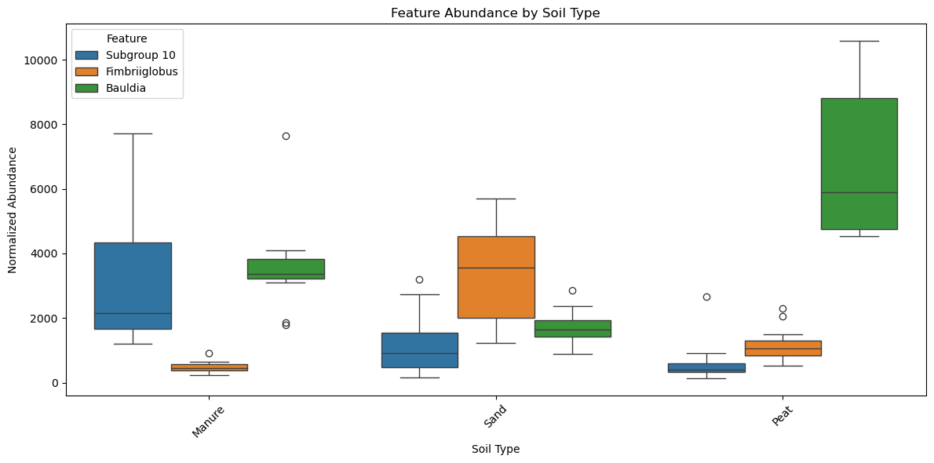
Boxplot of the Soil features abundance for Novaseq, LSVM

Slide 22
Next slides are related to SHAPG results

Slide 23
Accuracy results of Random Forest per each dataset (Feature selection/reduction applied)
Binary Classification
Multi-class Classification
Accuracy for Aviti
Condition | 20 SHAPG features | 10 SHAPG features | 3 SHAPG features
Autoclave | 0.88 | 0.66 | 0.77
Heat root | 0.44 | 0.66 | 0.66
Accuracy for Aviti
Condition | 30 SHAPG features | 3 SHAPG features
Soil | 1.0 | 0.88
Accuracy for Miseq
Condition | 20 SHAPG features | 10 SHAPG features | 3 SHAPG features
Autoclave | 0.77 | 0.77 | 0.44
Heat root | 0.44 | 0.55 | 0.44
Accuracy for Miseq
Condition | 36 SHAPG features | 2 (not 3) SHAPG features
Soil | 1.0 | 0.55
There were only 2 common features. See slide 25
Accuracy for Novaseq
Condition | 20 SHAPG features | 10 SHAPG features | 3 SHAPG features
Autoclave | 0.77 | 0.77 | 0.77
Heat root | 0.66 | 0.66 | 0.77
Accuracy for Novaseq
Condition | 32 SHAPG features | 3 SHAPG features
Soil | 1.0 | 1.0

Slide 24
Accuracy results of LSVM per each dataset (Feature selection/reduction applied)
Binary Classification
Multi-class Classification
Accuracy for Aviti
Condition | 20 SHAPG features | 10 SHAPG features | 3 SHAPG features
Autoclave | 0.77 | 0.66 | 0.77
Heat root | 0.55 | 0.55 | 0.44
Accuracy for Aviti
Condition | 30 SHAPG features | 3 SHAPG features
Soil | 1.0 | 0.88
Accuracy for Miseq
Condition | 20 SHAPG features | 10 SHAPG features | 3 SHAPG features
Autoclave | 0.77 | 0.77 | 0.55
Heat root | 0.44 | 0.66 | 0.33
Accuracy for Miseq
Condition | 37 SHAPG features | 3 SHAPG features
Soil | 1.0 | 0.88
Accuracy for Novaseq
Condition | 20 SHAPG features | 10 SHAPG features | 3 SHAPG features
Autoclave | 0.88 | 0.88 | 0.88
Heat root | 0.55 | 0.55 | 0.55
Accuracy for Novaseq
Condition | 32 SHAPG features | 3 SHAPG features
Soil | 1.0 | 1.0

Slide 25
List of Top 20 SHAPG Features for Aviti, Random Forest
Number | Autoclave (yes)'s SHAPG | HeatRoot (yes)'s SHAPG
1 | Rhodovarius | Micropepsis
2 | Xanthomonas | Thermaerobacter
3 | Mesobacillus | Lacihabitans
4 | Kaistia | Chryseotalea
5 | Telmatocola | Algoriphagus
6 | Pseudofulvimonas | Spirochaeta
7 | Gemmata | Acetobacter
8 | Imperialibacter | Thermobacillus
9 | Chthonobacter | Candidatus Arcanobacter
10 | Emticicia | [Polyangium] brachysporum group
11 | Niallia | Niastella
12 | Ramlibacter | Salinispira
13 | Reyranella | Luteibacter
14 | Baekduia | Halocella
15 | UBA6140 | Phreatobacter
16 | BBMC-4 | Tepidanaerobacter
17 | Conexibacter | Candidatus Bealeia
18 | Bdellovibrio | Erythrobacter
19 | AKYG587 | Massilia
20 | Neobacillus | Leeia
Number | Soil (Manure)'s SHAPG | Soil (Peat)'s SHAPG | Soil (Sand)'s SHAPG
1 | BIyi10 | Pusillibacter | oc32
2 | Pusillibacter | SWB02 | Chthonobacter
3 | Sneathiella | Acidovorax | Zavarzinella
4 | C1-B045 | Sneathiella | Ideonella
5 | Methylobacter | Chthonobacter | Planctopirus
6 | YC-ZSS-LKJ147 | Polycyclovorans | Sphingorhabdus
7 | Parafilimonas | BIyi10 | Labrys
8 | Fimbriiglobus | Methylobacter | Niveispirillum
9 | Planifilum | Planifilum | Fermentimonas
10 | Roseimaritima | C1-B045 | Agrobacterium
11 | Chthonobacter | Zavarzinella | Zhengella
12 | oc32 | Candidatus Solibacter | SWB02
13 | Gemmata | Sphingorhabdus | Polycyclovorans
14 | SWB02 | Ideonella | Croceibacterium
15 | Ideonella | Roseimaritima | Ureibacillus
16 | Acidovorax | Azotobacter | Planifilum
17 | Croceibacterium | Fimbriiglobus | Spirochaeta 2
18 | Agrobacterium | oc32 | Pusillibacter
19 | Polycyclovorans | Agrobacterium | Acidovorax
20 | Spirochaeta 2 | Zhengella | Gemmata

Slide 26
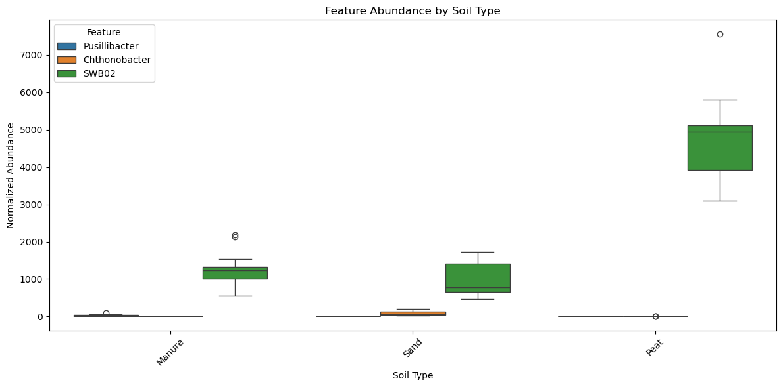
Boxplot of the Soil shapG features abundance for Aviti, Random Forest

Slide 27
List of Top 20 SHAPG Features for Miseq, Random Forest
→ Features of HeatRoot had 0 importance
Number | Autoclave's SHAPG | HeatRoot's SHAPG
1 | mle1-7 | Cytophaga
2 | Imperialibacter | Spirochaeta 2
3 | Chryseotalea | Paludibaculum
4 | Dokdonella | Tepidisphaera
5 | YC-ZSS-LKJ147 | Chitinophaga
6 | Parageobacillus | Niastella
7 | Ferruginibacter | Haliscomenobacter
8 | Hassallia | Ferruginibacter
9 | Rhodoplanes | Chitinophaga
10 | Phenylobacterium | Agriterribacter
11 | Dinghuibacter | Pedobacter
12 | Ilumatobacter | Bdellovibrio
13 | Chryseolinea | Pseudorhodoplanes
14 | Abditibacterium | Thermomonas
15 | Chthoniobacter | Chryseotalea
16 | Bauldia | OLB12
17 | Sumerlaea | Hassallia
18 | Hirschia | Ureibacillus
19 | Sediminibacterium | Phenylobacterium
20 | Methylobacillus | Luteolibacter
Number | Soil (Manure)'s SHAPG | Soil (Peat)'s SHAPG | Soil (Sand)'s SHAPG
1 | Dokdonella | Arsenicitalea | Bosea
2 | Gemmata | Ilumatobacter | Shinella
3 | Bradyrhizobium | Kineobactrum | Ferribacterium
4 | CL500-3 | SWB02 | Rubrivivax
5 | Sphingopyxis | Sphingopyxis | Sphingorhabdus
6 | Paludibaculum | Massilia | JGI 0001001-H03
7 | Arsenicitalea | CL500-3 | Methylophilus
8 | Shinella | Luteolibacter | Pedomicrobium
9 | mle1-7 | Planctomicrobium | OLB12
10 | JGI 0001001-H03 | mle1-7 | Dechloromonas
11 | Polycyclovorans | Methylophilus | Dokdonella
12 | Coxiella | Bradyrhizobium | Luteolibacter
13 | Kineobactrum | Gemmata | Pirellula
14 | Geomonas | Asticcacaulis | Sphingomonas
15 | Ilumatobacter | Coxiella | Xylophilus
16 | Croceibacterium | Pedomicrobium | Gaiella
17 | Planctomicrobium | Pseudomonas | Geomonas
18 | Ferribacterium | Duganella | Bradyrhizobium
19 | Dechloromonas | Methylibium | Methylibium
20 | Sphingorhabdus | OLB12 | Ilumatobacter

Slide 28
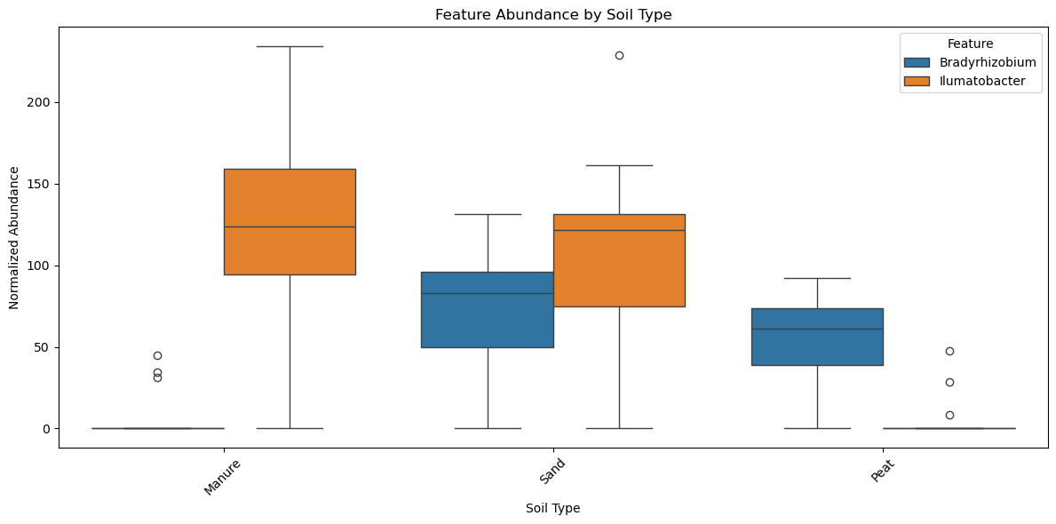
Boxplot of the Soil shapG features abundance for Miseq, Random Forest

Slide 29
List of Top 20 SHAPG Features for Novaseq, Random Forest
Number | Autoclave's SHAPG | HeatRoot's SHAPG
1 | Mesobacillus | Erythrobacter
2 | Brucella | Algoriphagus
3 | Ruficoccus | Lachnospiraceae UCG-004
4 | Kribbella | Apilactobacillus
5 | Candidatus Protochlamydia | Diaphorobacter
6 | Gemmata | Phycocomes
7 | Noviherbaspirillum | Desulfopila
8 | Desulfovibrio | Phragmitibacter
9 | Snodgrassella | Bordetella
10 | Ramlibacter | Meiothermus
11 | Immundisolibacter | Actinokineospora
12 | Ammoniphilus | Geothrix
13 | Subgroup 10 | Fundidesulfovibrio
14 | Papillibacter | Imperialibacter
15 | Altericroceibacterium | CL500-3
16 | Sorangium | Caedibacter
17 | Stenotrophobacter | Acrocarpospora
18 | Aquisphaera | Rhodovastum
19 | Dechloromonas | Skermanella
20 | Methylobacillus | Gemmobacter
Number | Soil (Manure)'s SHAPG | Soil (Peat)'s SHAPG | Soil (Sand)'s SHAPG
1 | Pusillibacter | Plot4-2H12 | Pseudarthrobacter
2 | Ruminofilibacter | Pseudarthrobacter | Plot4-2H12
3 | Plot4-2H12 | Runella | Runella
4 | Constrictibacter | Pusillibacter | Inhella
5 | Ketobacter | Dyadobacter | Ferribacterium
6 | Dyella | Fimbriiglobus | Dyadobacter
7 | Cerasicoccus | Leeia | IS-44
8 | Methyloceanibacter | Amaricoccus | Brevifollis
9 | Candidatus Berkiella | Ketobacter | Pararhizobium
10 | Ferribacterium | Ruminofilibacter | Leeia
11 | Hydrogenispora | Rhodopila | Solimonas
12 | Fimbriiglobus | Dechloromonas | Bauldia
13 | Methanosarcina | Brevifollis | Constrictibacter
14 | DSSD61 | Bauldia | Dechloromonas
15 | Afipia | Candidatus Berkiella | Afipia
16 | BIyi10 | Inhella | Dyella
17 | Runella | Solimonas | DSSD61
18 | IS-44 | BIyi10 | Caldicoprobacter
19 | Microbacterium | Flavimaricola | Candidatus Berkiella
20 | Rhodopila | Pararhizobium | Hydrogenispora

Slide 30
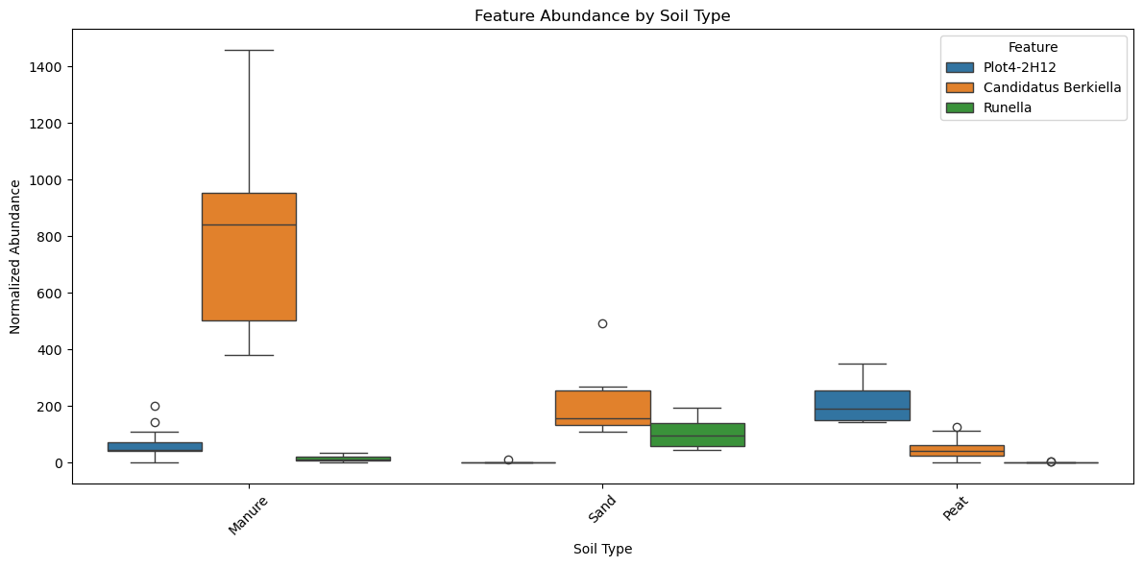
Boxplot of the Soil shapG features abundance for Novaseq, Random Forest

Slide 31
List of Top 20 SHAPG Features for Aviti, LSVM
Number | Autoclave (yes)'s SHAPG | HeatRoot (yes)'s SHAPG
1 | Xanthomonas | Erythrobacter
2 | Mesobacillus | Salinispira
3 | Pseudofulvimonas | Acetobacter
4 | Kaistia | Luteibacter
5 | Pusillibacter | Spirochaeta
6 | Rhodovarius | Propionicicella
7 | Imperialibacter | Tepidanaerobacter
8 | Baekduia | Thermaerobacter
9 | Methanosarcina | Leeia
10 | Aetherobacter | [Polyangium] brachysporum group
11 | Pelotalea | Mycobacterium
12 | Erythrobacter | OLB13
13 | OLB13 | Lentzea
14 | Hirschia | Roseateles
15 | BBMC-4 | Sediminibacterium
16 | Niallia | Lacihabitans
17 | Methylobacter | Candidatus Bealeia
18 | Niastella | Candidatus Ovatusbacter
19 | Tepidisphaera | Cavicella
20 | Emticicia | Allocatelliglobosispora
Number | Soil (Manure)'s SHAPG | Soil (Peat)'s SHAPG | Soil (Sand)'s SHAPG
1 | Pusillibacter | Methylobacter | oc32
2 | BIyi10 | Sneathiella | Chthonobacter
3 | Sneathiella | Pusillibacter | Sphingorhabdus
4 | C1-B045 | Labrys | Ideonella
5 | Methylobacter | BIyi10 | Zavarzinella
6 | Ureibacillus | C1-B045 | Labrys
7 | Parafilimonas | SWB02 | Niveispirillum
8 | Ideonella | Acidovorax | Planifilum
9 | Roseimaritima | Candidatus Solibacter | Planctopirus
10 | Planifilum | Roseimaritima | Azotobacter
11 | Chthonobacter | Agrobacterium | Polycyclovorans
12 | SWB02 | Sphingorhabdus | Agrobacterium
13 | Fimbriiglobus | Zavarzinella | Acidovorax
14 | Candidatus Solibacter | Hyphomicrobium | SWB02
15 | Gemmata | Chthonobacter | Spirochaeta 2
16 | Croceibacterium | Planifilum | BIyi10
17 | Hyphomicrobium | Planctopirus | Candidatus Solibacter
18 | Polycyclovorans | Fermentimonas | Cellvibrio
19 | oc32 | Cellvibrio | Ureibacillus
20 | Sphingorhabdus | oc32 | Fimbriiglobus

Slide 32
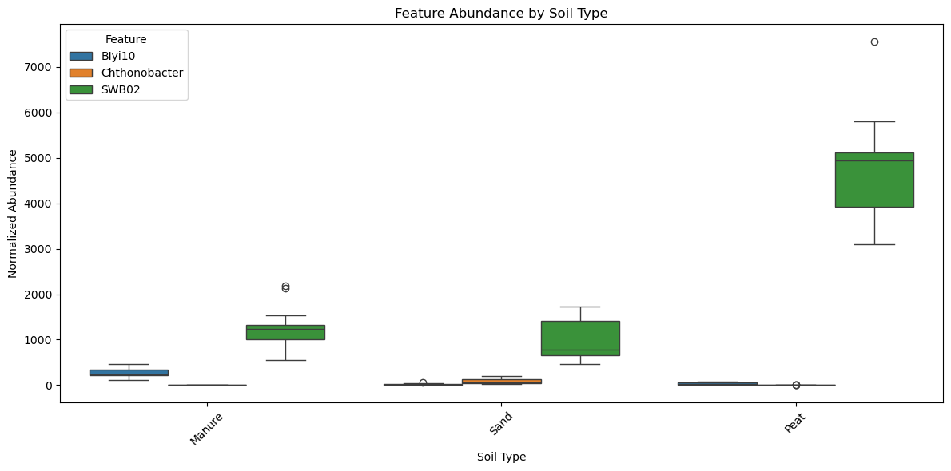
Boxplot of the Soil shapG features abundance for Aviti, LSVM

Slide 33
List of Top 20 SHAPG Features for Miseq, LSVM
Number | Autoclave (yes)'s SHAPG | HeatRoot (yes)'s SHAPG
1 | Mesobacillus | Pelagibius
2 | mle1-7 | YC-ZSS-LKJ147
3 | YC-ZSS-LKJ147 | Methylotenera
4 | Imperialibacter | UBA6140
5 | Panacagrimonas | Hydrogenophaga
6 | Dinghuibacter | Pseudolabrys
7 | Parageobacillus | Rhodoferax
8 | Chryseotalea | Aetherobacter
9 | Rhodoplanes | Pedobacter
10 | Abditibacterium | Phaselicystis
11 | Hassallia | Ilumatobacter
12 | Ferruginibacter | Paludibaculum
13 | Chryseobacterium | Chthonobacter
14 | Bauldia | Cereibacter
15 | Chthoniobacter | Cytophaga
16 | Chryseolinea | Ellin6055
17 | Dokdonella | Gemmobacter
18 | Lelliottia | Legionella
19 | Aquicella | Ferruginibacter
20 | Methyloceanibacter | Ureibacillus
Number | Soil (Manure)'s SHAPG | Soil (Peat)'s SHAPG | Soil (Sand)'s SHAPG
1 | Bradyrhizobium | Arsenicitalea | Shinella
2 | Dokdonella | Ilumatobacter | Sphingorhabdus
3 | CL500-3 | Sphingopyxis | Ferribacterium
4 | Arsenicitalea | Kineobactrum | Bosea
5 | Geomonas | SWB02 | Methylophilus
6 | Kineobactrum | Luteolibacter | Rubrivivax
7 | Polycyclovorans | Dokdonella | Dechloromonas
8 | Gemmata | Planctomicrobium | Luteolibacter
9 | Ilumatobacter | Paludibaculum | Geomonas
10 | JGI 0001001-H03 | OLB12 | Pedomicrobium
11 | Croceibacterium | Massilia | CL500-29 marine group
12 | Planctomicrobium | CL500-3 | Dokdonella
13 | Dechloromonas | Gemmata | Gaiella
14 | SWB02 | Methylophilus | Bradyrhizobium
15 | Paludibaculum | mle1-7 | OLB12
16 | Coxiella | Pseudomonas | Pirellula
17 | Opitutus | Opitutus | Sphingomonas
18 | Ferribacterium | Pirellula | SWB02
19 | Shinella | MND1 | JGI 0001001-H03
20 | Methylophilus | Aquicella | Acidibacter

Slide 34
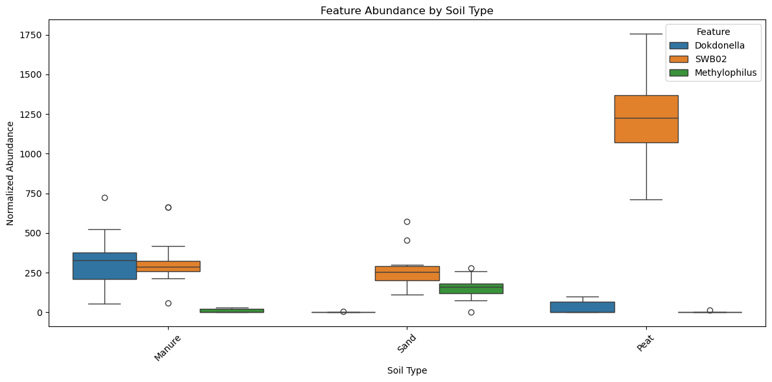
Boxplot of the Soil shapG features abundance for Miseq, LSVM

Slide 35
List of Top 20 SHAPG Features for Novaseq, LSVM
Number | Autoclave (yes)'s SHAPG | HeatRoot (yes)'s SHAPG
1 | Mesobacillus | Erythrobacter
2 | Brucella | Verticiella
3 | Candidatus Protochlamydia | Lachnospiraceae UCG-004
4 | Ammoniphilus | Phragmitibacter
5 | Immundisolibacter | Meiothermus
6 | Desulfovibrio | Phycocomes
7 | Aquisphaera | Desulfopila
8 | Brevibacillus | Diaphorobacter
9 | Niallia | Caedibacter
10 | Snodgrassella | Kribbella
11 | Crocinitomix | Geothrix
12 | OLB13 | Aquicella
13 | Taonella | Actinokineospora
14 | Pseudoxanthobacter | Bordetella
15 | Cupriavidus | Tuberibacillus
16 | Povalibacter | Fundidesulfovibrio
17 | Sandaracinobacter | Thermoclostridium
18 | Asticcacaulis | Hydrogenispora
19 | Ramlibacter | Edaphocola
20 | Sorangium | Novosphingobium
Number | Soil (Manure)'s SHAPG | Soil (Peat)'s SHAPG | Soil (Sand)'s SHAPG
1 | Pusillibacter | Pusillibacter | Pseudarthrobacter
2 | Ruminofilibacter | Ruminofilibacter | Plot4-2H12
3 | Methyloceanibacter | Constrictibacter | Runella
4 | Constrictibacter | Runella | Ferribacterium
5 | Ketobacter | Methyloceanibacter | Inhella
6 | Dyella | Pseudarthrobacter | Dechloromonas
7 | Methanosarcina | Ketobacter | Leeia
8 | DSSD61 | BIyi10 | Dyella
9 | Candidatus Berkiella | Amaricoccus | IS-44
10 | Amaricoccus | Plot4-2H12 | Brevifollis
11 | BIyi10 | Flavimaricola | Pararhizobium
12 | Microbacterium | Microbacterium | Dyadobacter
13 | Flavimaricola | Candidatus Berkiella | Solimonas
14 | Plot4-2H12 | Dyella | Caldicoprobacter
15 | Cerasicoccus | Leeia | Bauldia
16 | Fimbriiglobus | Dyadobacter | Methyloceanibacter
17 | Ferribacterium | Dechloromonas | Constrictibacter
18 | Caldicoprobacter | Pararhizobium | Afipia
19 | Afipia | Bauldia | Fimbriiglobus
20 | Subgroup 10 | Subgroup 10 | Hydrogenispora

Slide 36
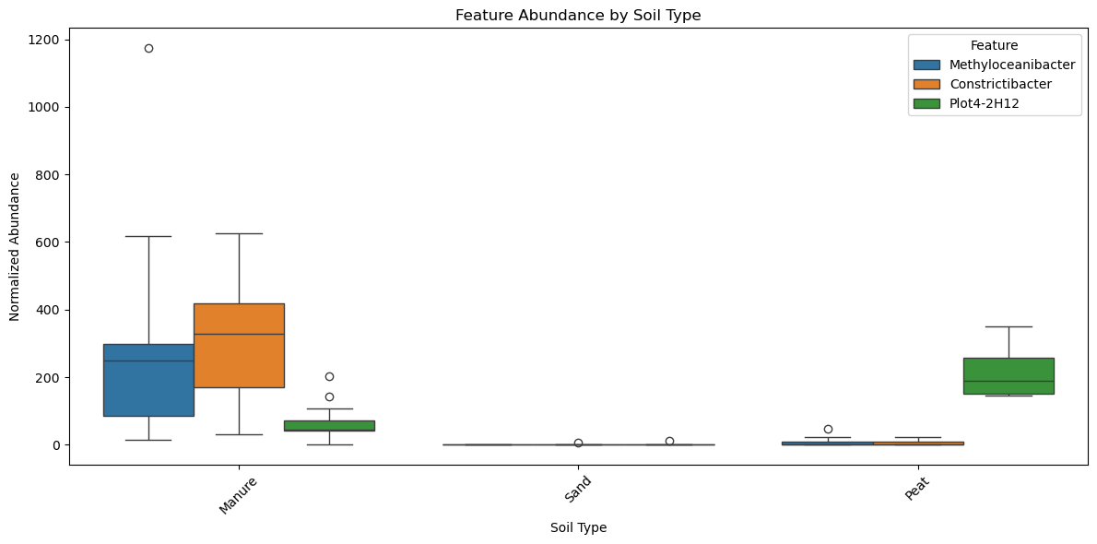
Boxplot of the Soil shapG features abundance for Novaseq, LSVM

Slide 37
The End

